Slide 1

Power BI

Slide 2
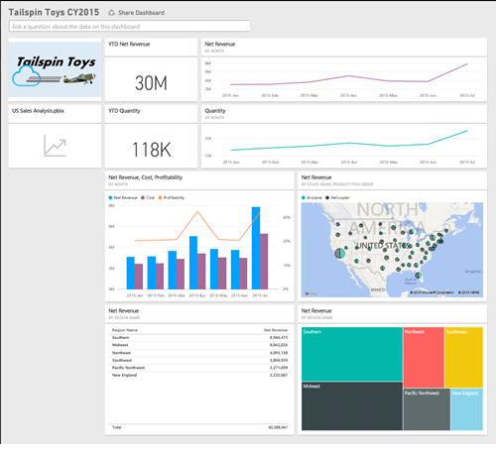
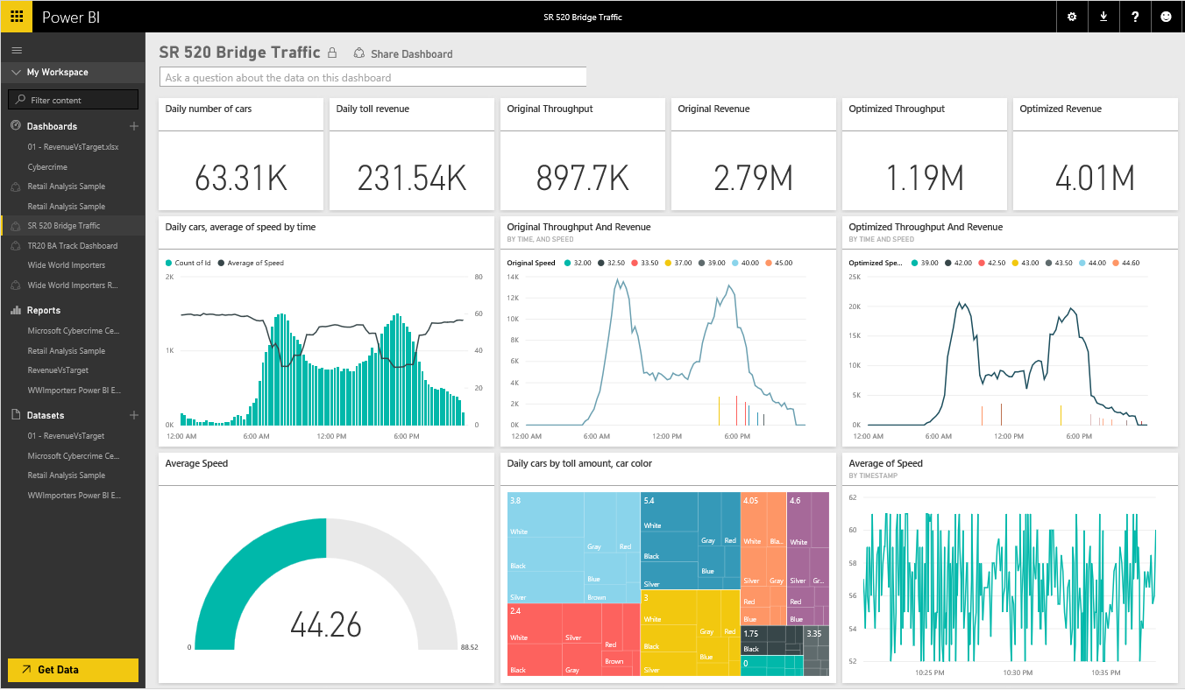
What is PBI?
Cloud-based analytics system that allows to access, edit and analyze data in real time and in a collaborative way.
*Sing up can be free, but it’s restricted to organizational accounts only.

Slide 3
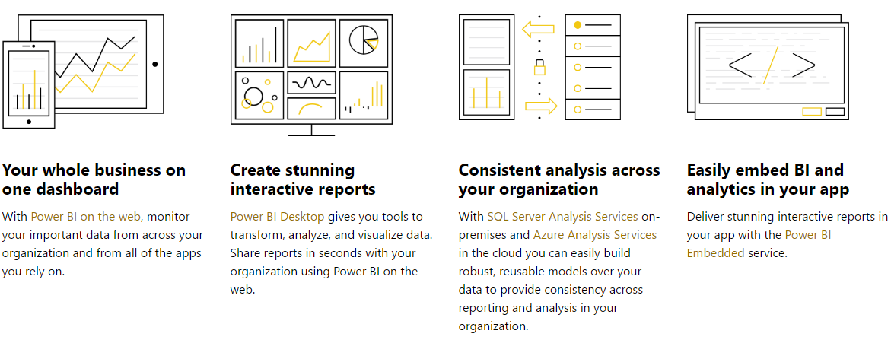
Power BI
Oriented to business customers (collaborative tool).

Slide 4
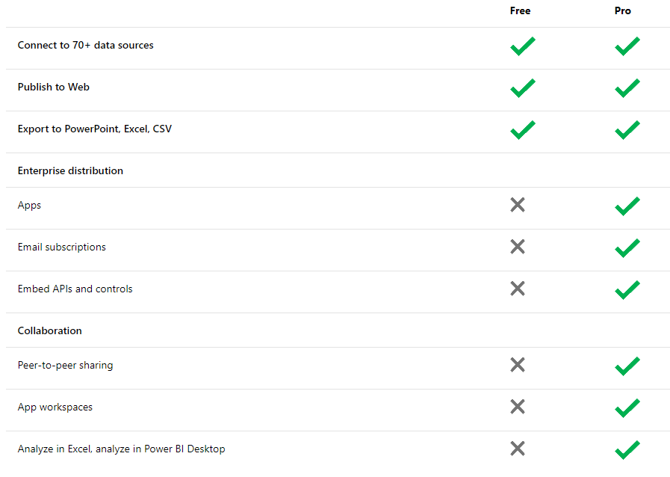
PBI Service Free VS Pro

Slide 5
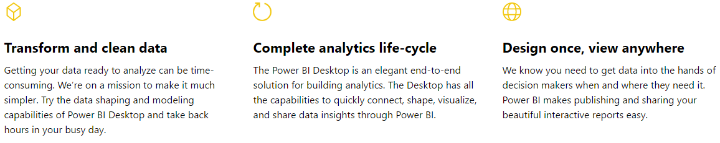
PBI Desktop
Oriented to regular customers (edition and uploading tool).

Slide 6
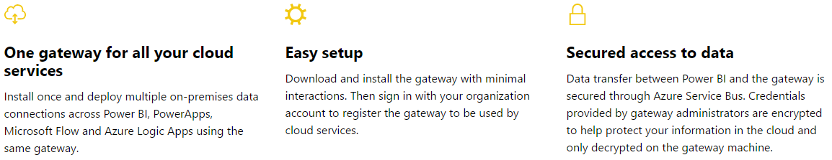
PBI Gateway
Server and Cloud tool.

Slide 7
Power BI Triage Plan Overview
Level of importance (1=low, 3=high) | Types | CSS Commercial Team Action | C+E Community Manager Action | Follow-up actions | Action ETA
1 | Kudos | None | Thank and engage user. | None. | N/A
1 | “Rants” | None. | None. | None. | N/A
1 | Remarks about competitors | None. | None. | Inform compete when appropriate. | N/A
1 - 3 | Inquiries on roadmap plans | Ask user to follow us to stay-up-to date with our releases. Example | None - CSS Commercial Team handles. | Document. Send to product marketing team. Alert PR if needed. | Depending on comment.
2 | Wish for new features/product enhancements | Thank. Direct user to Ideas page. | None - CSS Commercial Team handles. | Document feedback comments. Send to product marketing team. | Monthly.
2 | Feedback on products | Thank. Direct user to Ideas page. | None - CSS Commercial Team handles. | Document feedback comments. Send to product marketing team. | Monthly.
2 | Requests for PR contact (see notes)** | Direct to PR contact page. | None - CSS Commercial Team handles. | None. | N/A
3 | How-to requests | Provide information and/or links to support page. Send link to forum for immediate resources.* | None - CSS Commercial Team handles. | Document feedback comments. Send to product marketing team. | ASAP.
3 | Other Power BI requests (see examples on slide 7-9) | Obtain answer from appropriate contact via email, then respond to user. | C+E Community Manager CCd on email communication. | Document feedback comments. Send to product marketing team. | ASAP.

Slide 8
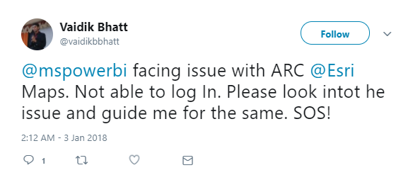
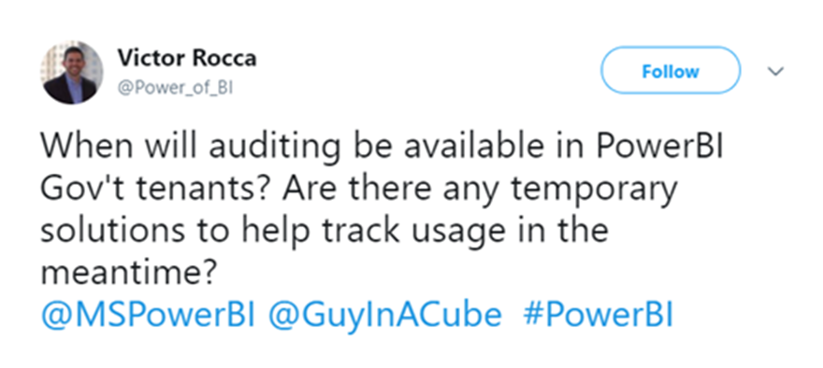
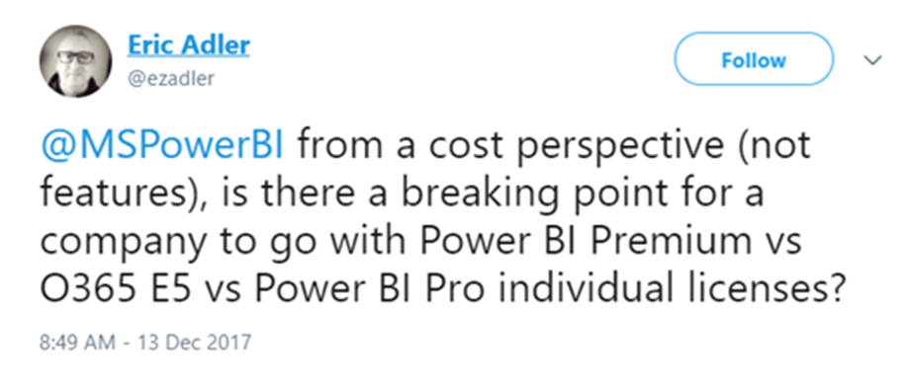
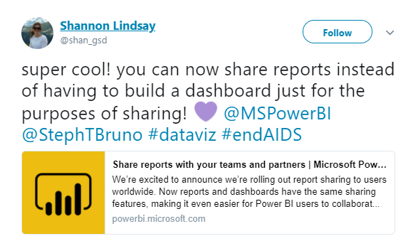
Power BI Triage Examples
How–to Issue or Inquiry
(CSS Commercial Team Responds)
Roadmap Inquiry
(CSS Commercial Team Responds)
Commercial Inquiry
(CSS Commercial Team Responds)
Positive Engagement Opportunity
(C+E Community Manager Responds)

Slide 9
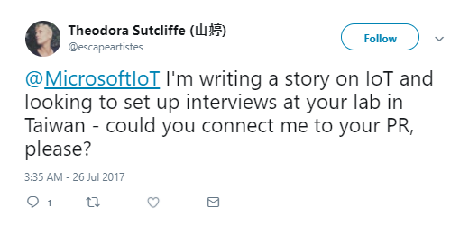
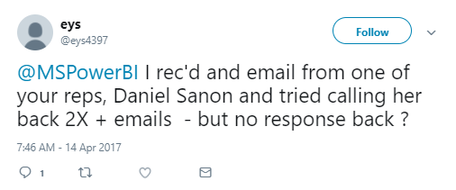
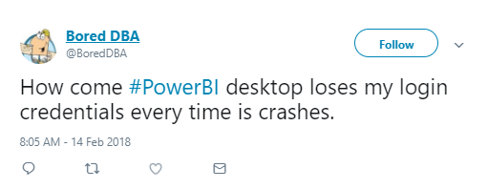

Power BI Triage Examples
PR Request
(CSS Commercial Team Responds- direct to PR Contact page)
Creative Asset Inquiry
(CSS Commercial Team Responds)
Reactive Content (Hashtags)
(C+E Community Manager Monitors & Assigns, CSS Commercial Team Responds)
Accessibility or Content Questions
(CSS Commercial Team Responds)

Slide 10
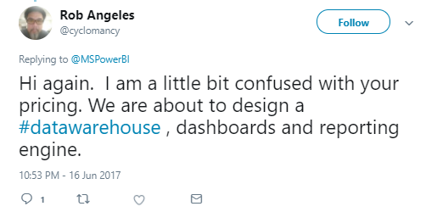
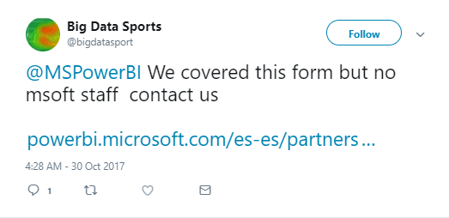
Power BI Triage Examples
Pricing Questions
(CSS Commercial Team Responds)
Website-related issues
(CSS Commercial Team Responds)

Slide 11
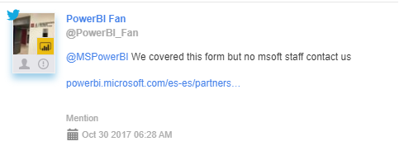

Web site related content
Customers following up on various forms submitted through PBI web sites ie:
https://powerbi.microsoft.com/en-us/partners/get-listed/
Broken links or broken sites ie:
This customer raised issue with broken links from:
https://dev.powerbi.com/apps
https://docs.microsoft.com/en-us/power-bi/developer/register-app#register-with-the-azure-portal.

Slide 12
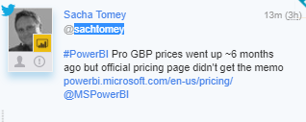
Pricing questions
Pricing questions:
This is something that we respond but ALWAYS in collaboration with Marketing teams or PMs. This is because a lot of the times there are either PR, or legal related questions/issues that come into play so we always look for

Slide 13
Influencers
For customers who have over 3K followers, even if the scope is technical and therefore CSS scope, Marketing teams usually require us to get approval before replying back. Let us know if you’d like us to align anything new.
Escalation: Send to Vielka first always.

Slide 14
Resources
News and announcements:
https://powerbi.microsoft.com/en-us/blog/
Documentation:
https://docs.microsoft.com/en-us/power-bi/
Guided learning:
https://docs.microsoft.com/en-us/power-bi/guided-learning/index
Forum:
http://community.powerbi.com/
Ideas (UserVoice):
https://ideas.powerbi.com/forums/265200-power-bi
GitHub:
https://github.com/powerbi
Analyze & Visualize Data with Power BI:
https://www.youtube.com/playlist?list=PL1N57mwBHtN0JFoKSR0n-tBkUJHeMP2cP
Stackoverflow:
http://stackoverflow.com/questions/tagged/powerbi

